Slide 1
Fishing Simulator VR
User Story 2
Yuxiao Zou

Slide 2
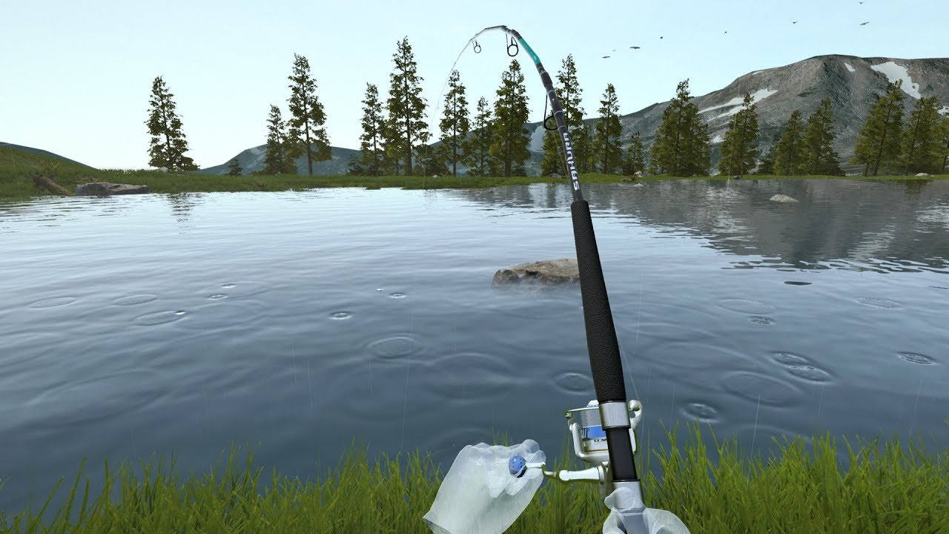
User Story
Jack now can walk around in the game and see the surroundings. And he also could see his left controller as a fishing rod. After walking several steps, he's now at a lake. He wants to see the fish in the lake and use the rod to catch the fish.

Slide 3
User Needs
Fish: Players need fish in the lake because it is required if they want to fish.
Fishing Hook: Players need fishing hook bind to the fishing rod because hook is the equipment to catch the fish.
Rod Handle: Players need a handle on the rod because they could wind up the string when the fish get hooked.

Slide 4
User Journey
Stand near water
Cast fishing hook
Wind up the string to catch the fish
Fish get hooked

Slide 5
The Experience
Players will remember the experience of fishing because it’s realistic. They will also enjoy the game since it’s easier to catch the fish compared to fishing in real world.

